Slide 1
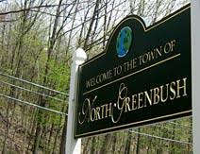
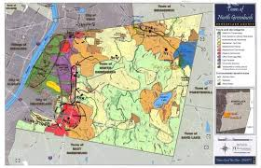
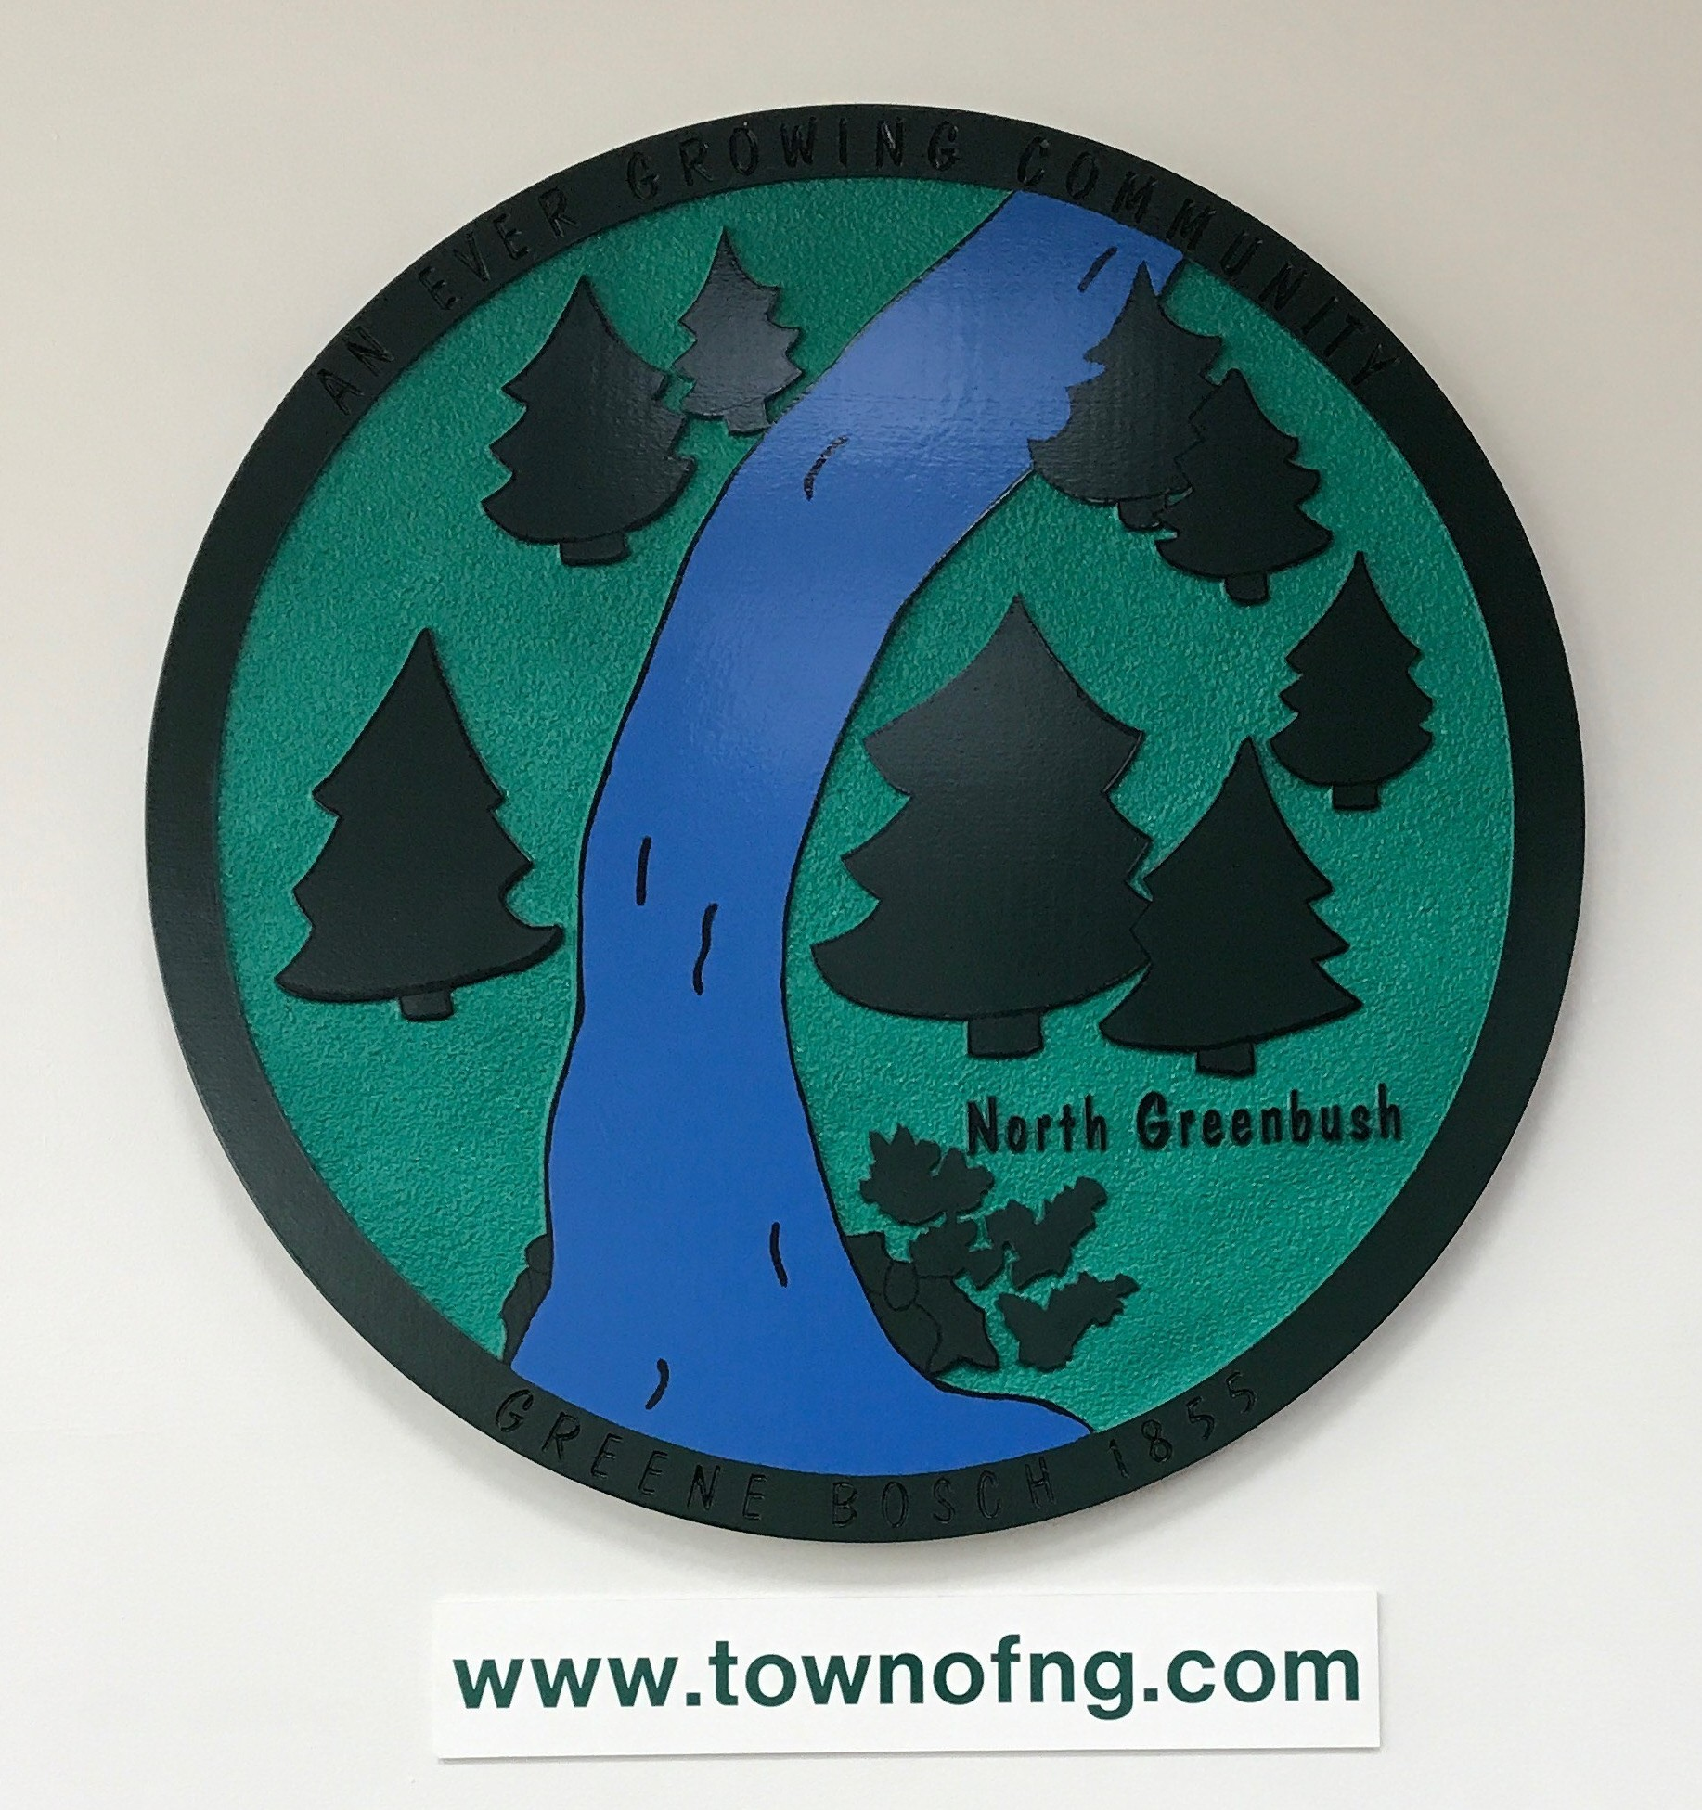
The Town of North Greenbush
Rensselaer County

Slide 2
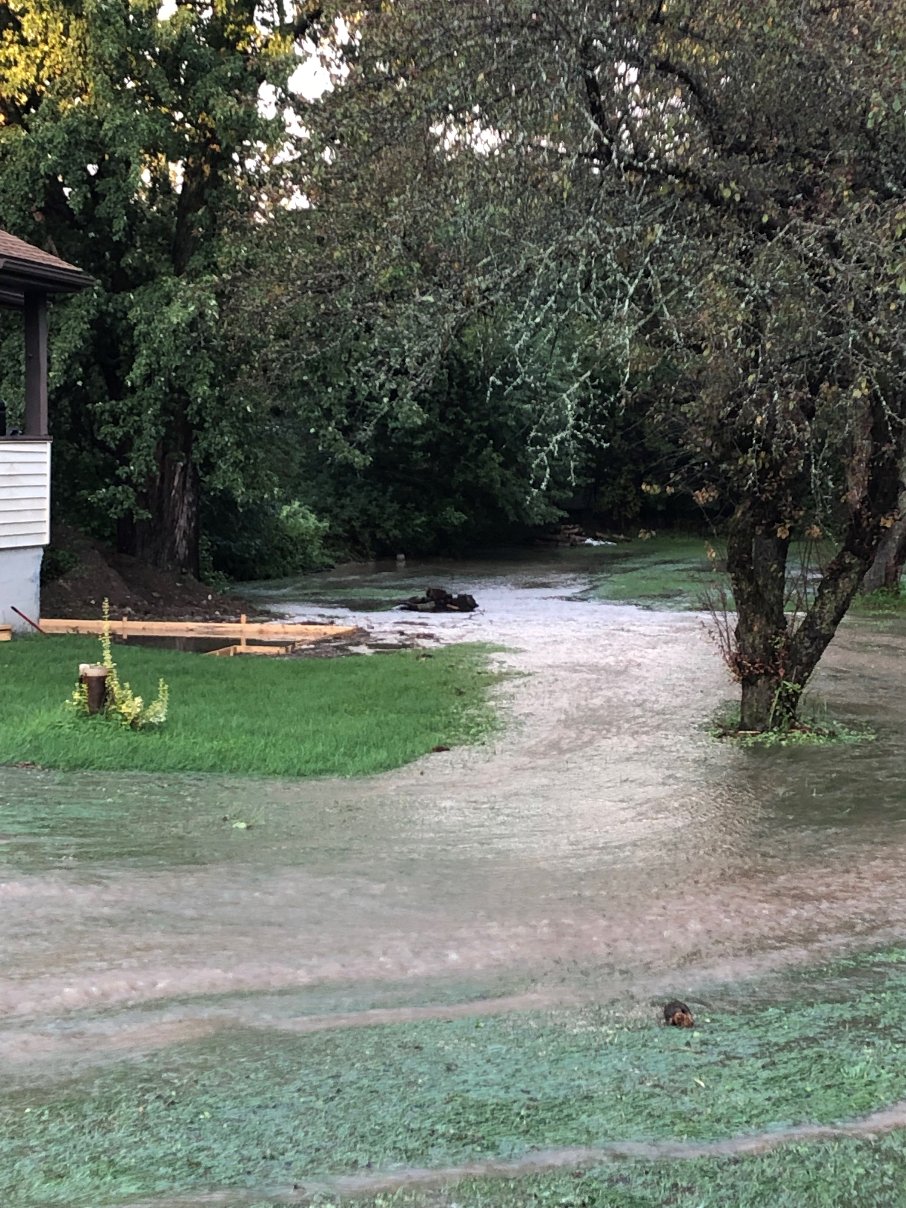
Climate Smart Resiliency Planning
Town of North
Greenbush
Rensselaer

Slide 3
Hudson Estuary Watershed Resiliency Project
A program of Cornell Cooperative Extension in partnership with the NYS DEC Hudson River Estuary Program, NY Water Resources Institute and Cornell University with support from the NYS Environmental Protection Fund.
www.blogs.cornell.edu/estuaryresilience
Notes:
The Hudson Estuary Watershed Resiliency Project is a program of Cornell Cooperative Extension in partnership with the NYS DEC Hudson River Estuary Program and the NYS Water Resources Institute at Cornell University, with support from the NYS Environmental Protection Fund.
The Estuary Program is a non-regulatory part of NYS DEC that has been focused on this unique region and its robust ecosystem for over 30 years. They help communities make decisions that benefit the ecosystem through engagement, education, technical assistance and grants. Their work aims to provide 7 key benefits to the region, and our program is under their resilient communities benefit.

Slide 4
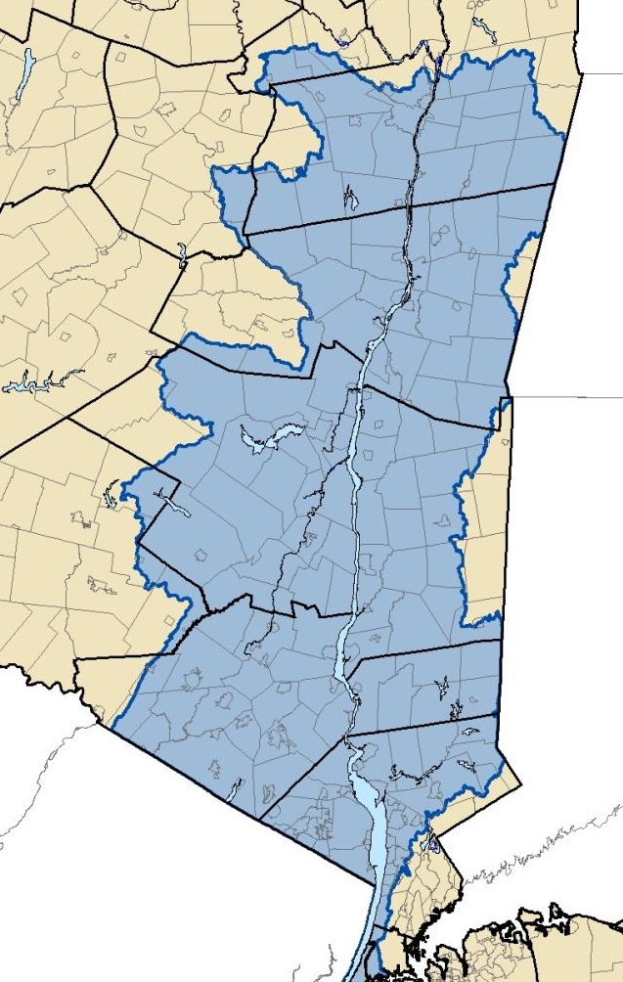
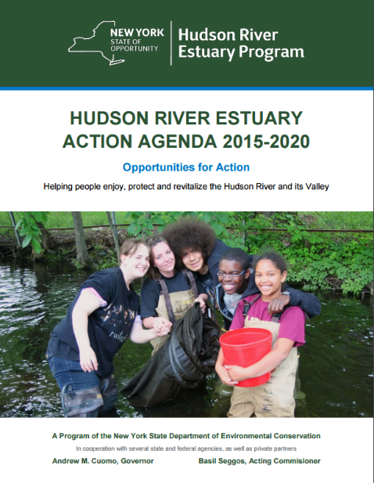
The Hudson River Estuary Program
Working to achieve
6 key benefits:
• clean water
• resilient communities
• vital estuary ecosystem
• fish, wildlife, and habitat
• natural scenery • education, access, recreation, and inspiration
http://goo.gl/NIJ3sg
Notes:
And then in 2012, along with CCE Columbia-Greene and CCE Orange, we began working to help Hudson Valley communities become more climate resilient through the Hudson Estuary Watershed Resiliency Project.
Since 2012 Cornell University and several Cornell Cooperative Extension (CCE) associations, in partnership with the NYS Water Resources Institute at Cornell University and with support from the NYS Department of Environmental Conservation’s Hudson River Estuary Program, have been leading this educational initiative.
The Project is a combination of research, demonstration, and educational outreach projects to address the challenges of flooding, stream and watershed management, and climate change.
The project currently includes CCE Dutchess, CCE Columbia-Greene & CCE Ulster and in years past it also included CCE Orange and CCE Rockland.

Slide 5
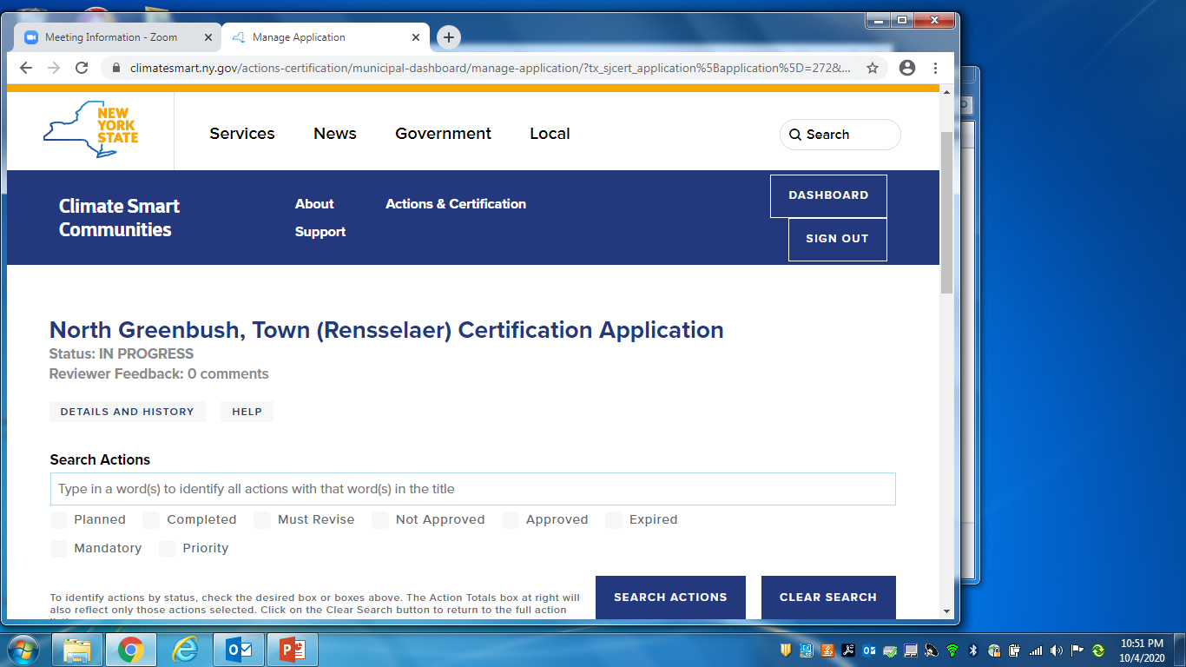
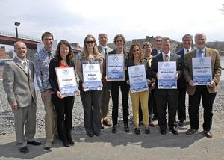
Climate Smart Communities Certification
https://climatesmart.ny.gov/
North Greenbush 2020
Notes:
The Climate Smart Communities (CSC) Certification program provides local governments with a robust framework to guide their climate action efforts, and recognize their achievements as they make progress. . Participation is free and voluntary.
Applicants can achieve one of three certification levels: bronze, silver, and gold. Levels are based on the total points earned and the completion of selected priority actions and pledge elements
Benefits include better scores on grant applications for some state funded resiliency grants, state level recognition, cost savings, etc.

Slide 6
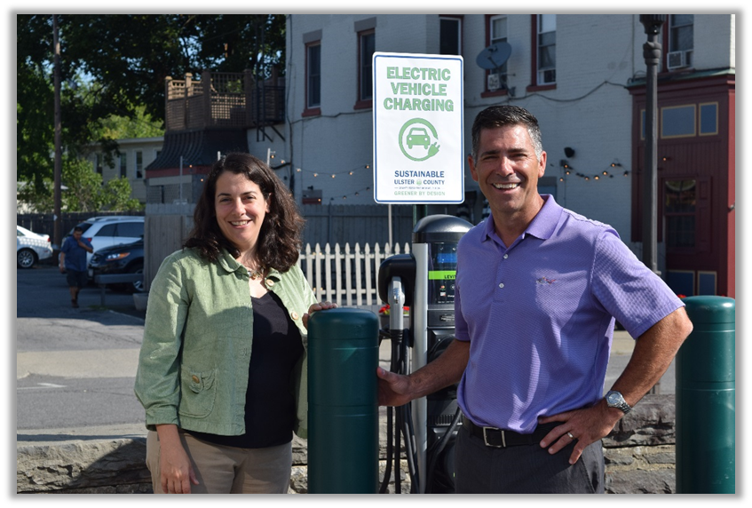
What are the benefits of becoming a Climate Smart Community?
Free technical assistance
Guidance: website, decision-support tools
Monthly webinars, email list, workshops
Certification program offers a frame work for planning with a menu of actions
Networking: learn with like-minded community leaders
Leadership recognition: state-level attention for local leaders
Funding: better positioned to compete for funds; CSC grants; ZEV rebates
Slide credit: Kristin Marcell, NYS DEC HREP
Notes:
Besides the general framework or road map that the CSC Certification provides communities there are many other benefits to becoming a Climate Smart Community.
Participating communities can receive free technical assistance when working to address any of the 130 actions outlined by the program.
In addition to direct technical assistance they can receive guidance through resources like the monthly webinars organized by the NY DEC Office of Climate Change
Communities who become certified in the program receive state-wide recognition for their leadership in addressing climate change
And they can also score higher in several of the competitive grant opportunities available now in New York State

Slide 7
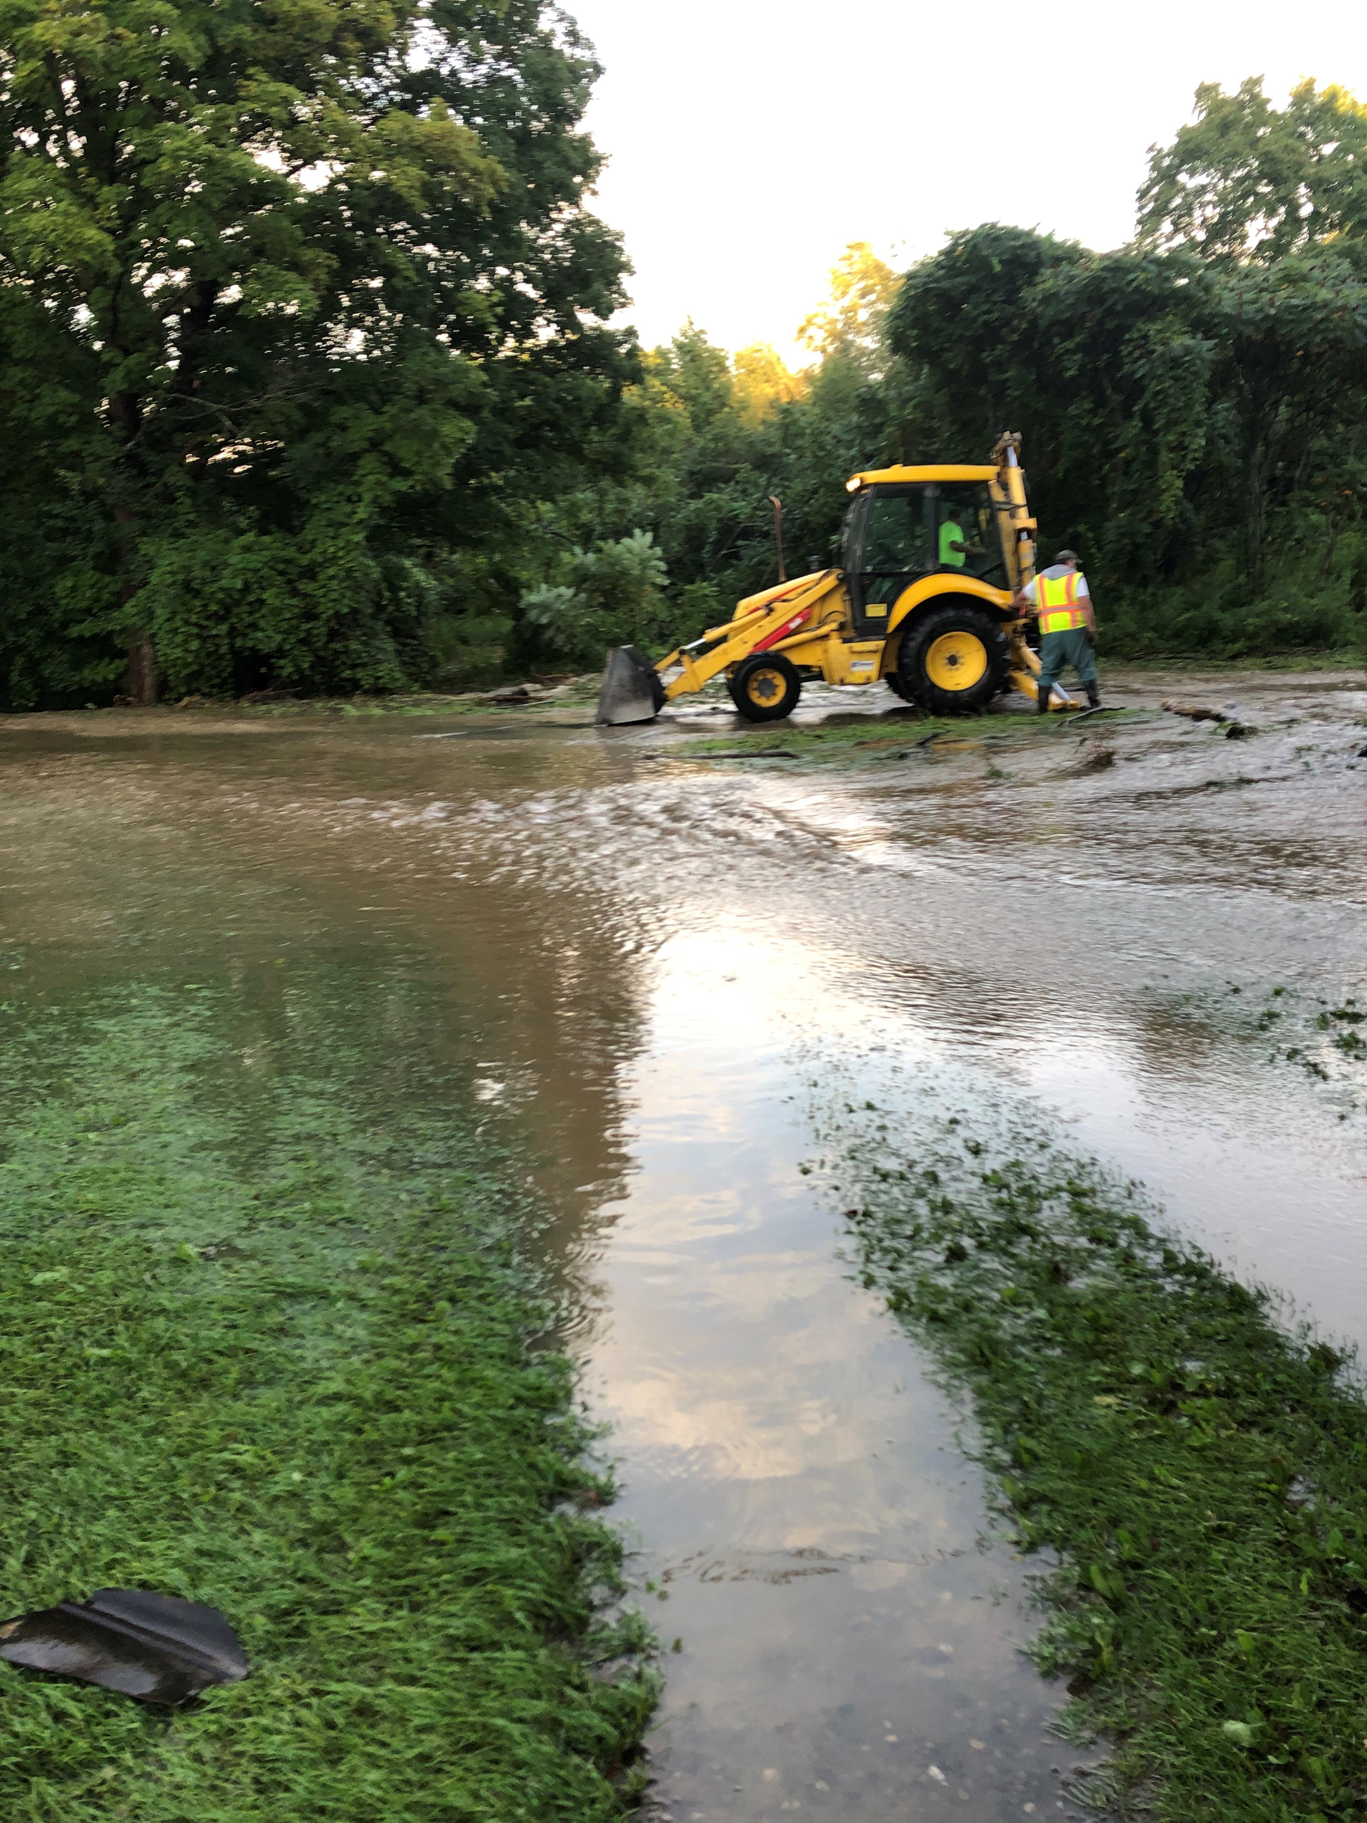
The CSRP tool covers six planning areas that are key for climate resiliency
Section 1 – Community Plan Checklist
Section 2 – Risk and Vulnerability Assessments
Section 3 – Public Outreach and Engagement
Section 4 – Planning Integration
Section 5 – Disaster Preparedness and Recovery
Section 6 – Hazard Mitigation Implementation
Slide credit: Libby Zemaitis, NYS DEC HREP – photo credit Mary Frances Sabo

Slide 8
Climate Smart Resiliency Planning Tool
Section 1: Commu+A2:F12nity Plan Checklist | Yes | No | Adoption Year | Update Frequency | Notes
1.1 Municipal Master Plan | x |  | 2009 |  | https://www.townofng.com/boards-committees/comprehensive-plan/final-plan-december-2009/
1.2 Zoning Ordinance | x |  | 1981 |  | Modified in 2016 -
1.3 Subdivision Ordinance | x |  | 1960 |  | Reviewed in the past couple of years by the Codes Committee
1.4 Open Space Plan | x |  | 2007 |  | Possibly put a committee together to review this
1.5 Natural Resource Conservation Plan | x |  | 2018 | 2018-2030 | Rensselaer Land Trust - https://www.renstrust.org/images/projects/ConservationPlanFinal/RLT-Conservation-Plan---Reduced-Quality.pdf
1.6 Stormwater Management Plan | x |  | 1980 |  | Will be updated this year based on comments by Eric Westfall the Storm Water Management officer.
A Community plan checklist that helps identify gaps at the beginning of the assessment process
Helps local decision makers identify planning and adaptation opportunities to improve resilience through existing planning mechanisms, public engagement, and disaster preparedness.
North Greenbush 2020

Slide 9
Climate Smart Resiliency Planning Tool
Completing the Climate Smart Resiliency Planning Tool satisfies Climate Smart Communities Certification Action 7.3, and is worth a total of 6 points.
The purpose of completing the tool is to reduce your community’s vulnerability to climate hazards such as extreme precipitation, flooding, storm surge, sea level rise, extreme heat, heat waves, and drought.

Slide 10
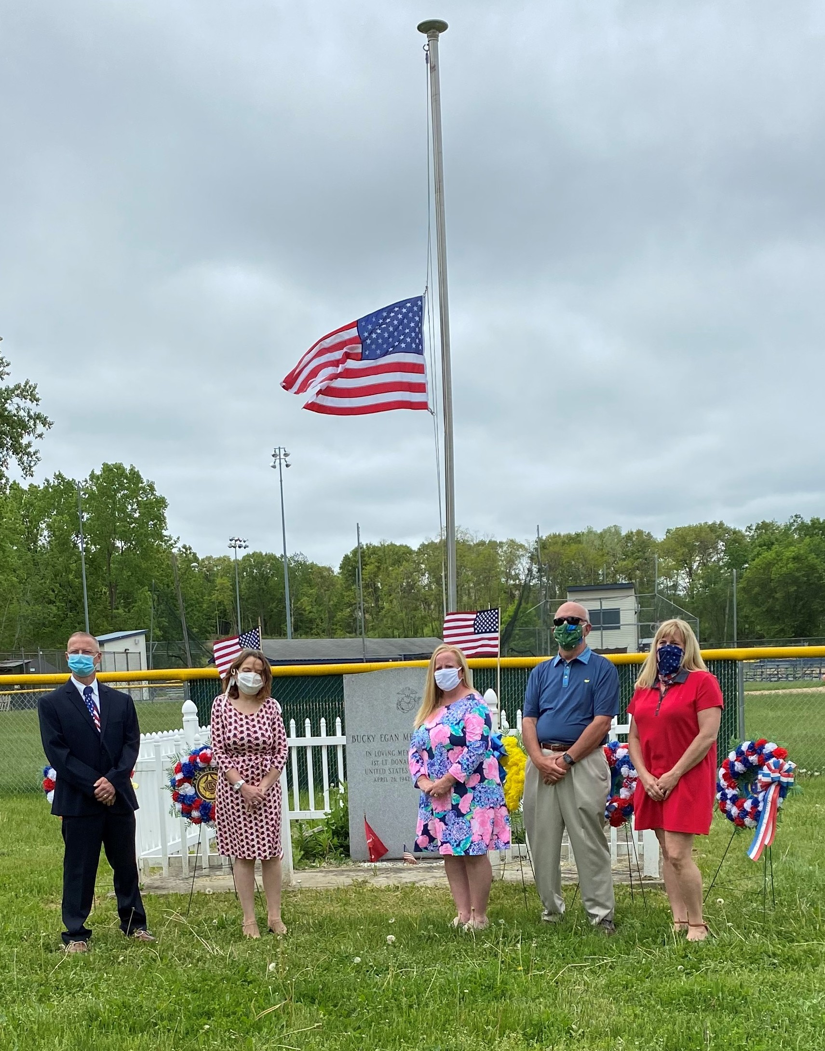
Deliverables & Outcomes
Completed CSRP Tool
Identify gaps in existing plans and policies
Next Steps - Recommendations
The Team!
Mary Frances Sabo – Town Councilwoman &
Chair of the Climate Smart Committee
Michael Miner – Town Building Department Coordinator
Eric Westfall – Town Engineer
David Wilson – Town Planning Board Member
Mark Premo – Highway Superintendent
John Greaves – Climate Smart Committee Member
Morgan Ruthman – Climate Smart Committee Member
Karl Lampson – Climate Smart Committee Member
Scott Noel – Climate Smart Committee Member

Slide 11
Climate Resilience Strengths Town of North Greenbush
The Town has taken the Climate Smart Pledge and has a motivated Climate Smart Committee.
Town is part of the National Flood Insurance Program and tracks repetitive loss properties
2020 Updated County Multi-Jurisdictional Hazard Mitigation Plan
Local Waterfront Revitalization Plan filed (1990)
Knowledgeable and hard working Town staff and Elected Officials dedicated to Strengthening the Town of North Greenbush.
Strong relationship with the RPI Tech Park (critical due to proximity to the Hudson River).

Slide 12
Rensselaer Technology Park

Slide 13
RPI Technology Park (RTP) Climate Smart Practices
The Rensselaer Technology Park Campus is comprised of approximately 1,250 acres. 660 of those acres are set-aside as undevelopable, resulting in valuable view shed and habitat protection. Climate Smart practices that have been adopted at the Tech Park over the past several years include, but are not limited to the following:
Over the last twenty years, the monarch butterfly population has decreased by 90%. The Tech Park has set-aside a two acre site to help save the monarch butterfly by growing vital habitat that support monarch breeding and migration patterns. The Tech Park is home to an official Monarchs in the Rough Foundation, Monarch Butterfly Habitat Site.
120 ash trees along Jordan Road and internal lanes are treated annually to mitigate the emerald ash borer. Thus far those treatments have been highly effective. In addition, the Tech Park has instituted a one-for-one tree replacement plan to offset the loss of trees due to illness or injury.
The Tech Park has the first ground mounted solar farm in the Town of North Greenbush, constructed at the GE Healthcare facility. The solar farm offsets approximately 8% of the annual electric usage at the facility. The Tech Park office worked with GE to develop a site plan that included site grading and landscaping so as to minimize any visual impacts from Stone Clay Road.
The Tech Park organizes frequent electronic recycling events.
The Rensselaer Environmental Health and Safety department collects and disposes of spent batteries, light bulbs and lighting ballast at the Tech Park and these materials are disposed of in an environmentally responsible manner.

Slide 14
RPI Technology Park (RTP) Climate Smart Practices
Over the last several years the Tech Park has implemented water conservation measures with respect to landscaping activities. Open areas of the Tech Park are mowed less frequently (reducing carbon emissions in the process) and seasonal landscaping that are water intensive are being removed and some planting areas are being replaced with hardscape materials.
The Tech Park has master planned design guidelines for the development of any of its parcels. Included are stringent guidelines with respect to the preservation and protection of wetland areas and the creation of storm water prevention and retention requirements that exceed the minimum design requirements.
The Tech Park has implemented measures to reduce light pollution, also known as light trespass. The Tech Park is designated as an E2 area of low ambient brightness. Our goal is to maintain or improve that rating by replacing high intensity light trespass exterior fixtures with down directed light fixtures. The Tech Park is replacing street light and parking lot lighting with LED fixtures with dimmable/sensor capabilities. Exterior wall packs, typically one of the largest sources of trespass light, are being replaced with less intense, wall washing spreads.
The Rensselaer Lighting Research Center (LRC) conducted a demonstration project where the Tech Park retrofit 270 existing, obsolete fluorescent lighting fixtures at 125 Jordan Road and installed state of the art controls and sensors to best manage energy usage. This project is innovative because it will be the first time that an independent lighting laboratory conducted field research in an occupied commercial space and are able thereafter to accurately measure, calculate and compare performance energy savings, operation and occupant feedback/acceptance of the lighting system options.
The Tech Park requires street and building signage be back-lit and not lamped from the ground or from above.

Slide 15
RPI Technology Park (RTP) Climate Smart Practices
Bloomingdale Brook is the largest stream within the Park and approximately three acres and 3,000 linear feet of the brook was part of a substantial wetlands habitat improvement project. The goal was to create a more desirable ecological habitat, including the installation of swales, spillways and ponds and desirable tree and shrub plantings. Today, that habitat has flourished, resulting in a premier wetland environment of its type.
For over 20 years, the Tech Park and the Town of North Greenbush have maintained a small system of walking trails for use by Park tenants and local residents. The trails are approximately 3.2 miles. The most used trail is the loop trail on Global View Road. The one mile loop trail was recently renovated with support from nearby Tech Park tenant Regeneron Pharmaceuticals.
The Tech Park expects to install three dual port EV charging stations by the spring of 2021.

Slide 16
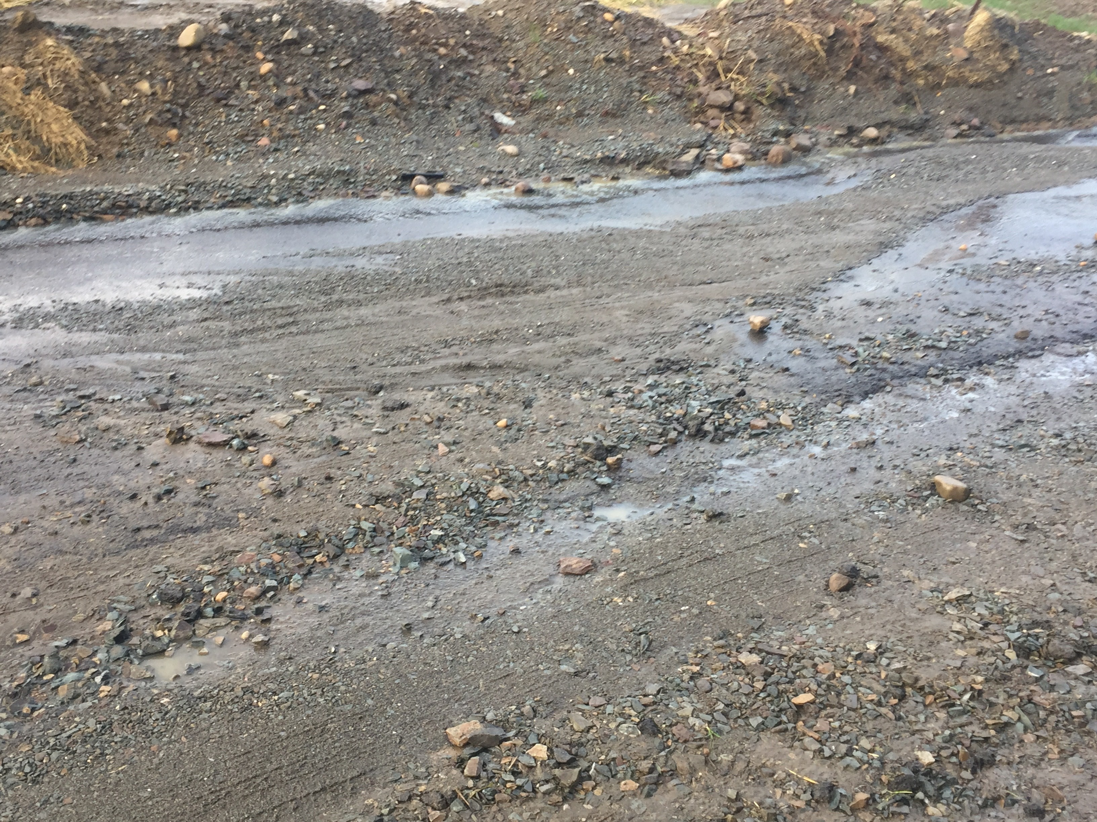
Areas of Opportunity Town of North Greenbush
Strengthen storm water management plans
Update the Town Comprehensive Plan to include climate resiliency/sustainability
Explore the inclusion of ZEV and charging station capacity
Make the final CSRP Tool available to residents – town website
Initiate steps toward becoming a Climate Smart Certified Community

Slide 17
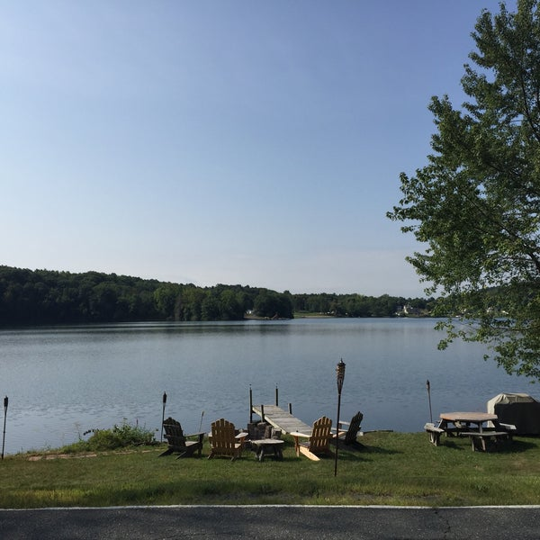
Storm Water Management Comprehensive Plan Update - Sustainability Town of North Greenbush
Update Storm Water Plan
Mapping
Developers - Over Retaining
Update the Town Comprehensive Plan to include climate resiliency/sustainability elements
When updating the Comprehensive Plan within CSC PE6 Action: Comprehensive Plan with Sustainability Elements (3-21 pts).⁶

Slide 18
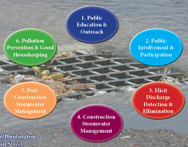
Stormwater Management Program (SWMP) Plan
The Town of North Greenbush SWMP Plan has been developed to comply with the New York State Department of Environmental Conservation General Permit for stormwater discharges to is a Municipal Separate Storm Sewer Systems (MS4s). The SWMP consists of six main program elements designed to reduce the discharge of pollutants. These elements, titles Minimum Control Measures, are as follows:
MCM 1: Public Education and Outreach
MCM 2: Public Involvement/Participation
MCM 3: Illicit Discharge Detection and Elimination
MCM 4: Construction Site Runoff Control
MCM 5: Post-Construction Stormwater Management
MCM 6: Pollution Prevention/Good Housekeeping for Municipal Operations

Slide 19
Stormwater Management Program (SWMP) Plan
The Town works to meet the MCM Goals in many ways …
Annual review and update of the SWMP - Updating Stormwater Laws
Submission of Annual MS4 Report - Public Website and Bulletin Board
Public Activities - Illicit Discharge Mapping and Inspections
SWPPP Review - Site Stormwater Inspections
Stormwater Management Areas - Good Housekeeping BMPs
Minimization of Pollutants - Standardization of Procedures
Participation in the Rensselaer County Stormwater MS4 Communities Coalition
Participation in the Climate Smart Community Program
Establishment of a Stormwater Management Website and Emergency Contact

Slide 20
Climate & Stormwater Natural Resource Remedies
Trees
Curb climate change directly by removing carbon dioxide from the atmosphere.
By catching rainwater, reducing erosion, and creating more permeable soils, trees help prevent nearly 400 billion gallons of runoff annually in the continental U.S.
The U.S. Forest Service estimates that on average, 100 mature trees keep about 140,000 gallons of water a year from flowing into storm sewers.
Wetlands
Sequester significant amounts of carbon.
Mitigate flooding by storing/slowly releasing rainfall and runoff.
Filter water.
Groundwater recharge / groundwater discharge (i.e. springs).
Biodiversity hot spots.
Aesthetics & recreation.
Over half of our original wetlands in the lower 48 states have been drained and converted to other uses.
Slide Compliments of John Greaves

Slide 21
Town of North Greenbush Climate Smart Community Presentation Topic: EV Charging Stations
Overview
NYSERDA Charge Ready Program
National Grid EV Charging Station Program
DEC Municipal Zero-emission Vehicle (ZEV) Rebates
Slide Compliments of Morgan Ruthman

Slide 22
Overview
New York State’s renewable energy initiative, Reforming the Energy Vision (REV), was launched in 2014 and has the stated purpose of “transforming the way electricity is produced, bought and sold in New York and enabling the integration of renewable energy generation and smart grid technologies on the electric grid”.
NYSERDA’s Charge Ready program is among REV’s 40+ programs and provides rebates of $4,000 per charging port for Level 2 charging stations installed at public, workplace, and multi-unit dwelling parking lots.
The NYS Public Service Commission (PSC) also recently expanded its “Make Ready” program to incentivize utilities and charging station developers to site electric vehicle charging infrastructure; “Make Ready” incentives are available in the Capital Region through National Grid’s EV Charging Station program.
Slide Compliments of Morgan Ruthman

Slide 23
NYSERDA Charge Ready Program
The Charge Ready program offers incentive funding to applicants for purchase and installation costs of electric vehicle charging stations.
Incentives are currently capped at $4,000 per charging port; most Level 2 stations have 2 ports, resulting in $8,000 per station.
Covered costs can include charging station, activation costs, installation costs, and subscription costs of hosting platform.
Application process is managed through NYSERDA portal and requires initial outlay by applicant; refund in 30-60 days from final approval.
Link: https://www.nyserda.ny.gov/All-Programs/Programs/ChargeNY
Slide Compliments of Morgan Ruthman

Slide 24
National Grid EV Charging Station Program
National Grid offers “Make Ready” funding for the electrical infrastructure costs required to service EV charging stations.
Incentive funds are currently being revamped for 2021 and should cover up to 90% of “Make Ready” work, with funds payable directly to approved installer; funding currently “capped” at $5,000/station.
Covered costs include site assessment, installation of underground electrical infrastructure, and concrete pedestal with bolt pattern.
Charging station is owned by the applicant and National Grid owns and maintains the electrical infrastructure.
Link: https://www.nationalgridus.com/Upstate-NY-Business/Energy-Saving-Programs/Electric-Vehicle-Charging-Station-Program
Slide Compliments of Morgan Ruthman

Slide 25
DEC Municipal Zero-emission Vehicle (ZEV) Rebate
The DEC offers:
(1) rebates to municipalities for purchase or lease eligible new zero-emission vehicles for fleet use;
(2) grants to municipalities for installation of electric vehicle charging stations for public use; and
(3) grants to Climate Smart Communities for eligible climate mitigation and adaptation projects.
DEC funding and NYSERDA Charge Ready incentives cannot be pursued for same installation.
EVs with an electric range of 51 miles or greater are eligible for rebates of $5,000, and eligible vehicles must be new and be placed into municipal service at a dealership in New York State.
In 2020 $500,000 was available to municipalities for the purchase or lease of eligible vehicles for fleet use. 2020 funding currently depleted; need to stay tuned for 2021 funding allocation and application timeframe.
Link: https://www.dec.ny.gov/energy/109181.html
Slide Compliments of Morgan Ruthman

Slide 26
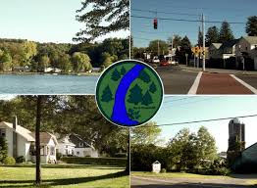
Recommendations Town of North Greenbush
Update Storm Water Plans/ mapping
Update the Town Comprehensive Plan - resiliency/sustainability
Explore the inclusion of ZEV and charging station capacity
Make the final CSRP Tool available to residents – town website
Continue steps toward becoming a Climate Smart Certified Community

Slide 27
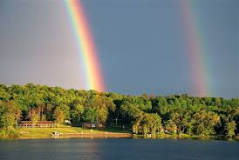
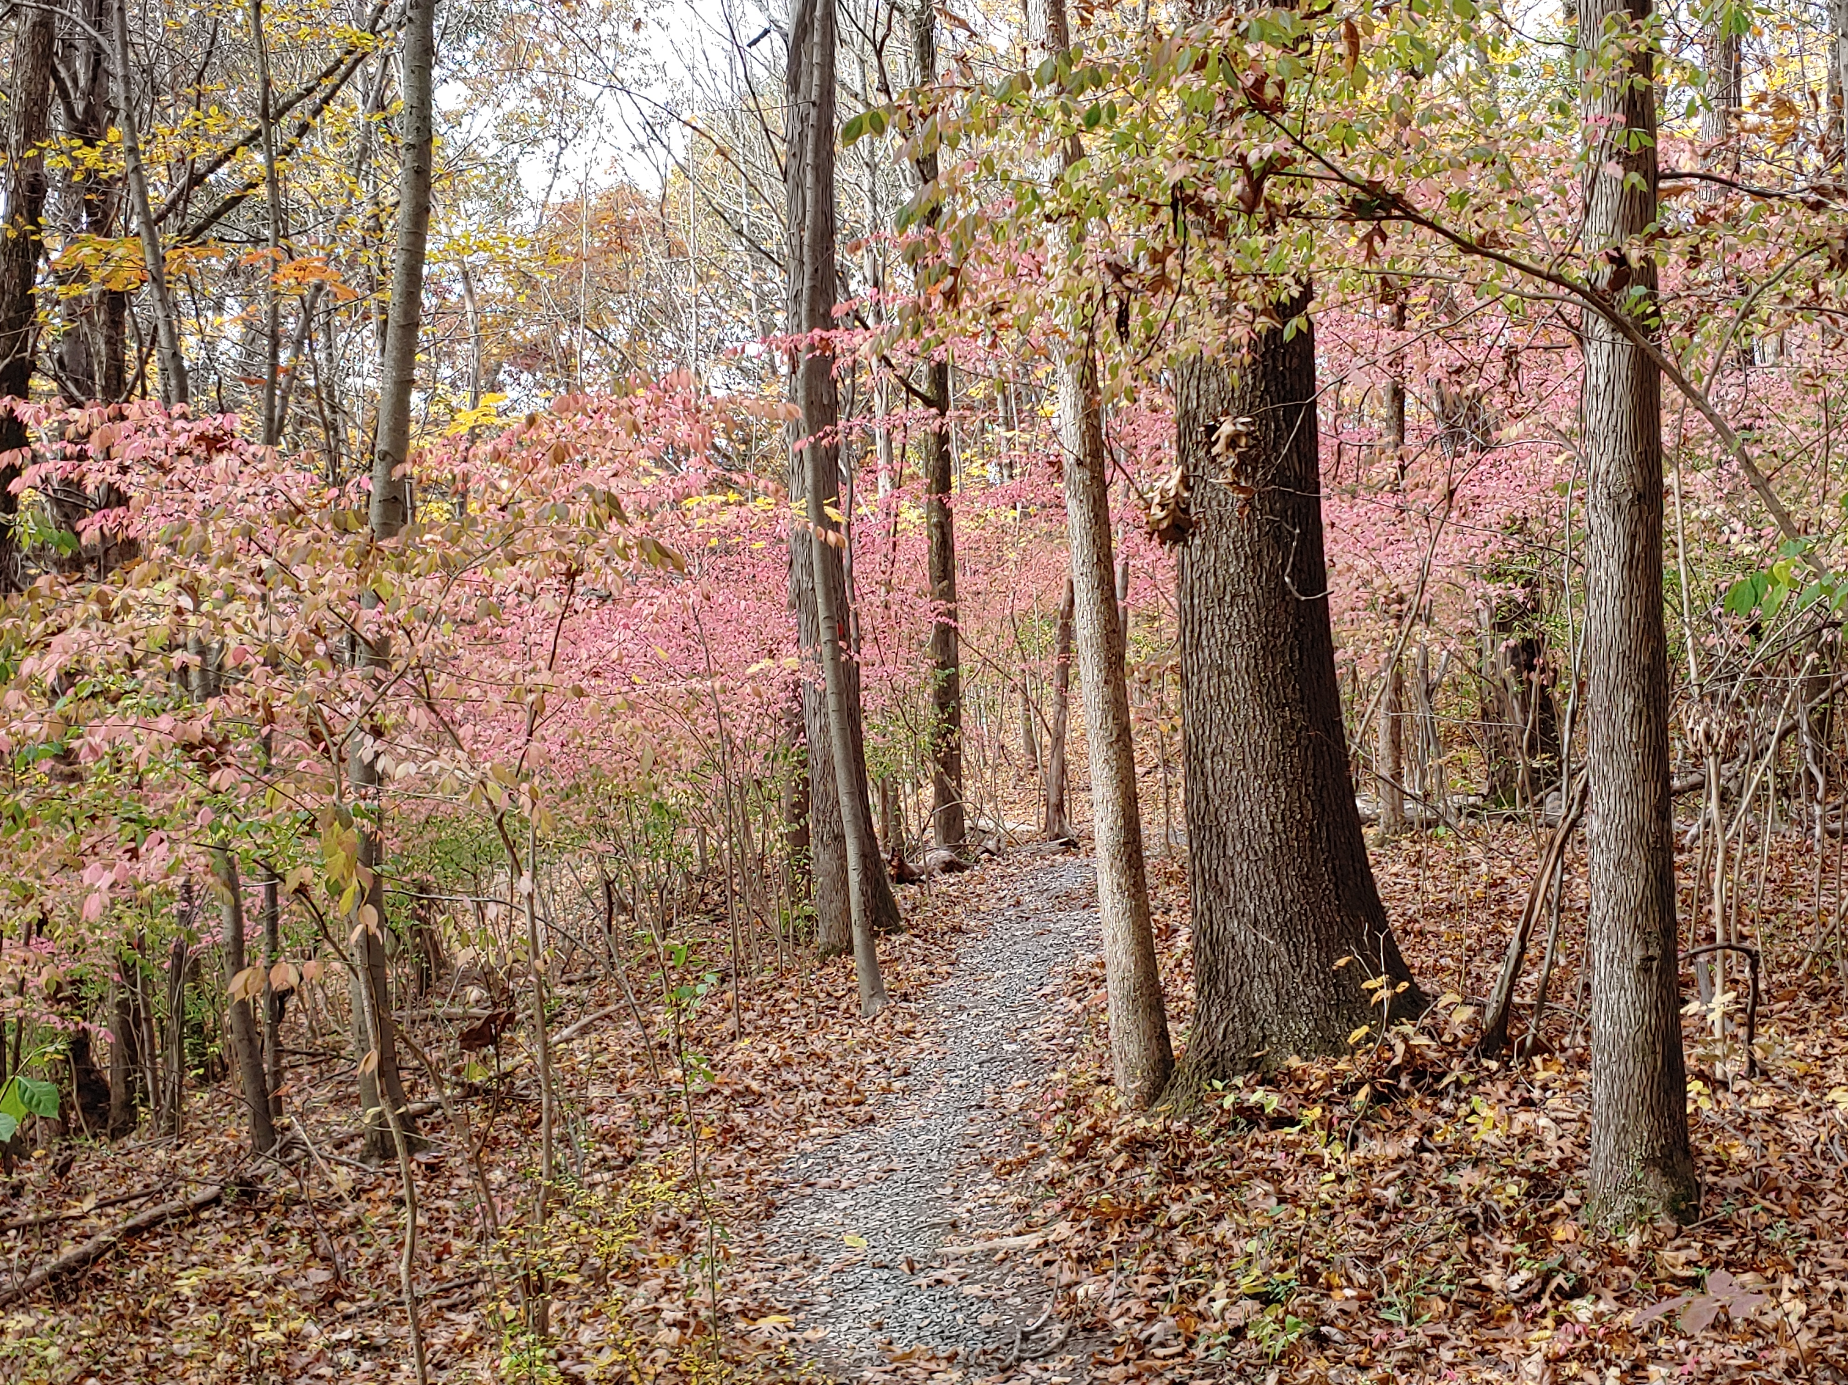
Contact Information
Mary Frances Sabo
Councilwoman-Chair CSC
msabo@northgreenbush.org
Town of North Greenbush
2 Douglas St.
Wynantskill, NY 12198
P 518-424-1884
F 518-283-5345
townofng.com/
Bernie Wiesen
Executive Director
bw27@cornell.edu
Cornell Cooperative Extension
Rensselaer County
61 State Street
Troy, NY 12180
P 518-272-4210
F 518-272-1648
Ccerensselaer.org
North Greenbush 2020

